Slide 1


Lesson 5:
THE BABYSITTER’S BACKPACK
Business of babysitting

Slide 2

BUSINESS OF BABYSITTING
Lesson 5.A

Slide 3

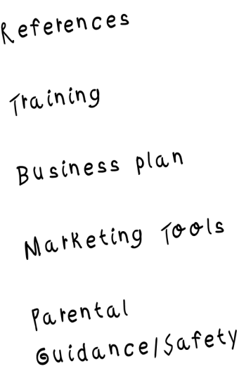
Take Notes!
It’s important
to have these things to effectively market yourself

Slide 4

Providing References
parents want to see that you have experience and training
You will need at least 3 references available to prove your experience.
You may want to use a teacher and two parents (other than your own) who can assure new parents you work well with children.
Always be sure to ask permission before using someone as a reference.

Slide 5
Providing References
parents want to see that you have experience and training
If you need to build references and experience, volunteer to babysit for a family while the parents are home.
That way, the parents can see how you work with children.
After observing you, they can become your references.

Slide 6

Required Training
parents are trusting you with their most important person: their child
Provide parents with a copy of your training certificate from this course.
Provide parents with a copy of your CPR and first aid certificate
Give parents a copy of your resume so they can learn more about you and your work with children.

Slide 7
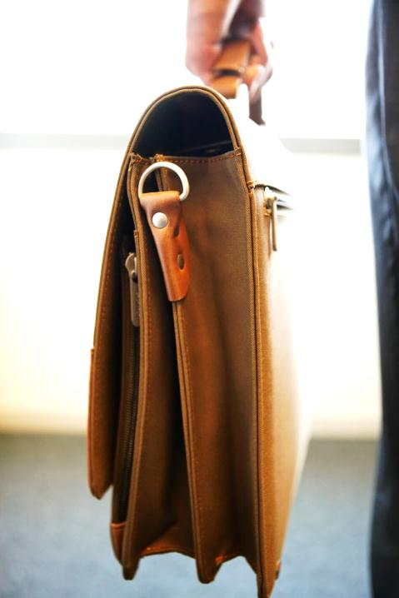
your Business Plan
babysitting is not only caring for children, it is a business
How much will you charge an hour? Most babysitters charge between $8.00 - $12.00, but it is important to ask around for your area. (See the reference page for help calculating area rates)
Decide your babysitting hours. When do you want to babysit: weekend, weeknights, summer?
What will you do with your babysitting money? It’s important to set financial goals, so you will not spend all the money you make.

Slide 8
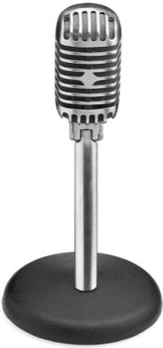
Marketing Tools
its important for families to know you are available to babysit
Resume – for families to learn more about you (See Printable 1, Lesson 5)
Business Cards – for families to access your information quickly (See Printable 2, Lesson 5)
Flyers – to target a large group of people, especially on community bulletin boards (See Printable 3, Lesson 5)

Slide 9

Keep Safety in Mind always!
When building your business, keep safety in mind at all times
Don’t put your address on flyers you post in a neighborhood
Only give personal information to families your parent or guardian approves
Never give personal information to a stranger!

Slide 10
Create your own marketing kit
Prepare a resume, cover sheet, business cards, and flyers for your babysitting business. Find an adult who will critique it for you!
when you are finished, answer the questions to the right.
What was it like for you to create your own resume?
Have someone critique your resume using the resume critique form. How did you do?
How might you use your resume in your new business?
What is the importance of marketing yourself?

Slide 11
5.A resources
https://www.care.com/babysitters
Babysitter Pay Rates
See printables for resumes, business cards, and flyers.
Have questions?
Look for more info on these websites.

