Slide 1


Lesson 1:
THE BABYSITTER’S BACKPACK
babysitting breakdown

Slide 2

Food, bedtime, & clean-up
Lesson 1.B

Slide 3

Before we start,
what are your experiences?
Take a few minutes and answer these questions. When you are done, go to the next slide.
What are some excuses you used to prolong bedtime when you were a child? Did any work? List as many as you can.
What are some important things to consider when feeding children?

Slide 4

before feeding children…
Dietary Restrictions & Allergies
Keep all sharp objects
out of reach.
If using the oven or stove, make sure they do not touch it.
Keep all perishable food
properly refrigerated.
Know what foods they are allowed to eat!
AND MOST IMPORTANTLY, REMEMBER TO…

Slide 5
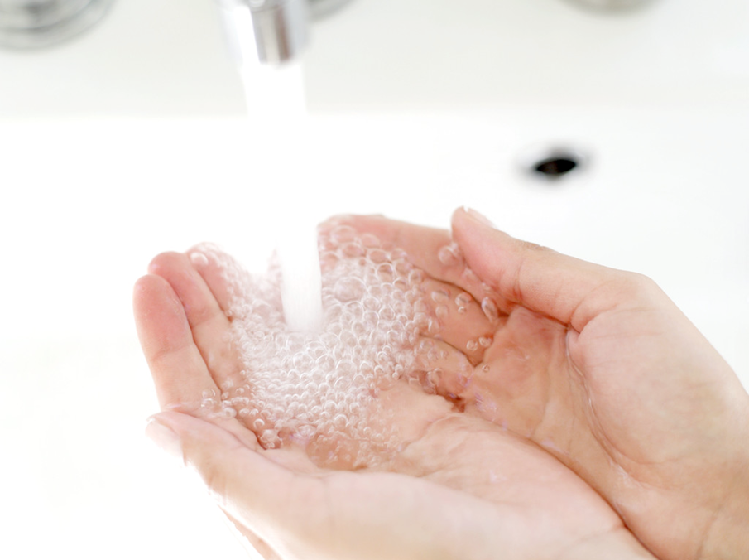
Wash everyone’s hands!!
Why wash hands?
How do we wash hands?
Washing hands is the best way to prevent the spread of germs and keep children healthy.
Use warm water (not hot) to avoid scalding
Test the water before letting the children put their hands in it
Wet hands and lather with soap
Make sure to all the areas of the hand
Rinse well with water
Dry with a paper towel

Slide 6
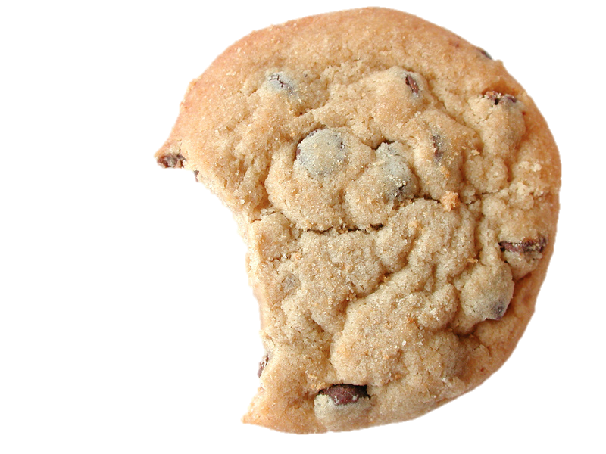
Om nom nom!
Involve kids in food time and have them help you choose and prepare the snacks.
Model good choices by picking healthy foods for you to eat.
Do not overload the children’s plates. Remember that children don’t need as much food, so pay attention to portion size.
If you are feeding the children dinner, try to include a fruit, a vegetable, protein, and grains. Always encourage them to drink milk, juice, or water.

Slide 7
Healthy Snacks
Fruit
Pretzels
Yogurt
Applesauce
Baby Carrots
Celery Sticks
Jell-O
Cheese Cubes
Nuts*
*check for allergies

Slide 8


Food reasons for misbehavior?
HUNGRY
makes
cranky
Notes:
Be patient with hungry kids! Hunger can make anyone tired and cranky, so the next time you face a temper tantrum, check to see if its near snack time!

Slide 9


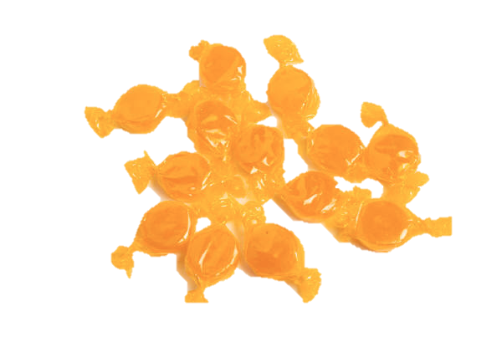

Food reasons for misbehavior?
Sugar
makes
crazy*
*REALLY HYPER and DISTRACTED!
Notes:
Candy and ice cream is exciting! Combine with a quick blast of sugar, and you might have some hyper kids to watch!

Slide 10

eat together!
DON’T eat in front of the television. Children consume much more food because they are not paying attention.
DO eat together as a group. Encourage them to eat with you at the table and keep them engaged in conversation.
(check out printable 3.2 for fun conversation starters!)

Slide 11
feeding a baby
Feeding a baby a bottle is a lot of fun! Before the parents leave, you need to find out a few things.
Are bottles already prepared or do you need to make them?
If the baby uses formula, where is it located?
How often should the baby eat?
How should you clean the bottles?
Grab a doll or stuffed animal. Watch the video on the following slide and practice along with the video.

Slide 12

feeding a baby

Slide 13

Go to sleep!
Bedtime can be a struggle for children and the babysitter.
Keep the following things in mind when helping the children prepare for bed.

Slide 14

Following the bedtime routine
Ask the parents to explain their children’s bedtime schedule. This will help the child feel more natural during the bedtime routine.
Avoid any caffeine or sugar at least an hour before bedtime.
Find out if they need a bath before bed. If so, try to start baths an hour before bedtime.
Have the children brush their teeth (you may need to supervise) and put on their pajamas.

Slide 15

Following the bedtime routine
Do something quiet for the last half hour before bedtime. Try working on a puzzle, reading books, or listening to music.
When it is time to put the children in bed, sit with them for a few minutes before you leave the room. Share with them how much you enjoyed playing with them.
Be patient! The children may be scared or nervous because their parents are not there. Reassure them and help them back into bed if they get out to see you.

Slide 16
putting the kids to bed
This next clip shows you how to make sure the bedding area is safe for the child.
Watch the video and think about how you would put a child to bed.

Slide 17

putting the kids to bed

Slide 18
Sleeping + SIDS:
WHAT’S THE CONNECTION?
SIDS (Sudden Infant Death Syndrome) is a devastating occurrence. There are no signs of cause of death, and many different factors may contribute to or cause SIDS.
Most sources agree that you should:
  Place an infant to sleep on their back, not their stomach
  Make sure there is nothing in the crib that could suffocate, strangle, or entrap the infant
  Check on the child at frequent intervals to ensure nothing is wrong

Slide 19

Shh!
Now they’re sleeping,
safe & sound.
Keep the television or other noise low so you can hear the children if they need you. If possible, use a baby monitor so you can hear them at all times.
Don’t get too distracted—check on them every 30-45 minutes to make sure they are okay.
Anytime they get out of bed, return them safely to their room.
While they are sleeping, you can clean-up any messes you or the children made while babysitting.

Slide 20

To Clean… or not to clean…
Many parents have mixed feelings on whether or not babysitters should clean up.
Some parents don’t want you to take time away from their child, while others expect the house to look like they left it (or better!).
It is best to ask the parents what their expectations are concerning cleaning.

Slide 21

If you are watching an infant, it may be too difficult to clean bottles and toys while the baby is awake. If this situation arises, offer to help clean-up things when the parents return home.
If you do have time and you know the children are safe, clean-up any dishes or toys that you used while babysitting.
While parents may not expect it, going the extra mile ensures that you will be asked back. Your job does not require doing extra chores, but it is a huge help to parents if they do not have to clean when they return home.

Slide 22
1.B References
Have questions?
Look for more info on these websites.
Putting children to bed?
www.wikihow.com/Put-a-Babysitting-​Charge-to-Sleep
www.ehow.com/how_2221610_put-children-​bed-babysitting.html
Want to make fun snacks with the children? Here are some fun recipes to try:
www.familyfun.go.com/recipes
www.perpetualpreschoo.com
Try this interactive food pyramid!
www.nourishinteractive.com

